Slide 1
Docker
Presented by Rahamthulla Shaik

Slide 2
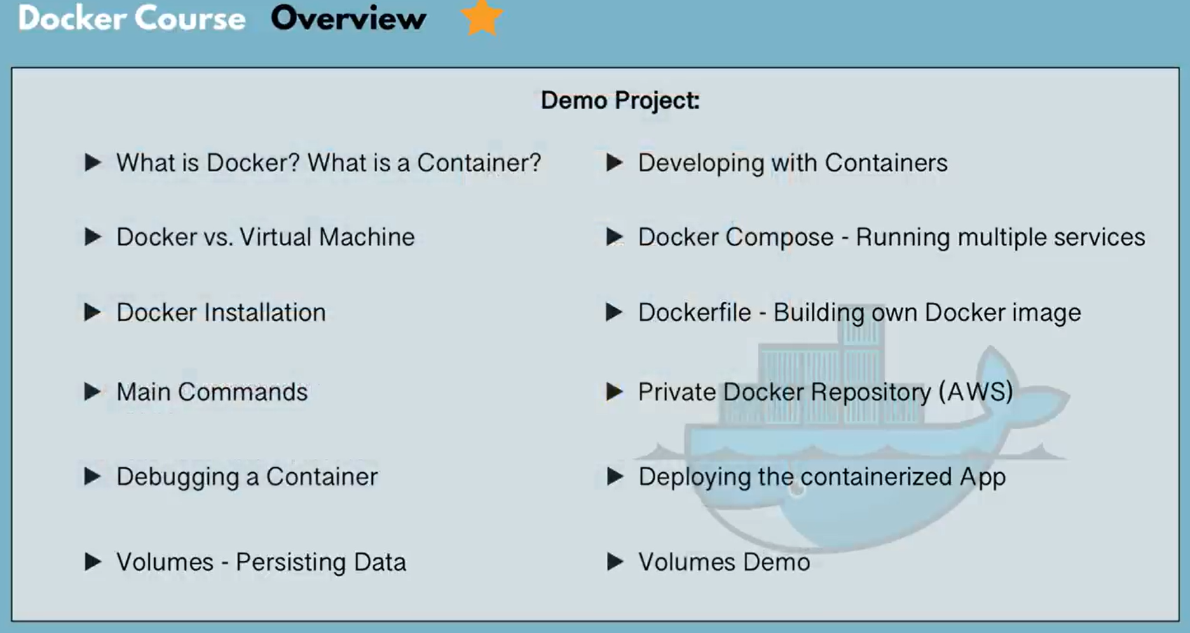

Slide 3
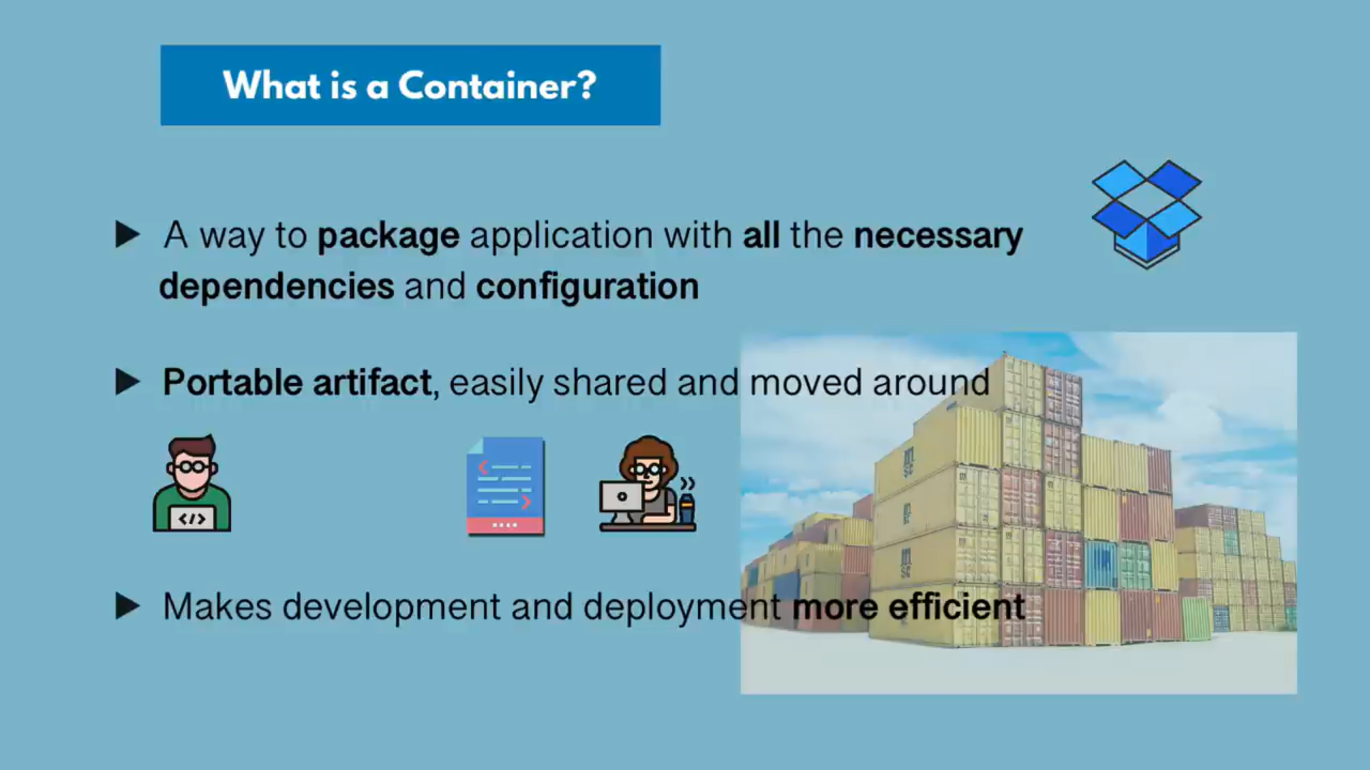

Slide 4
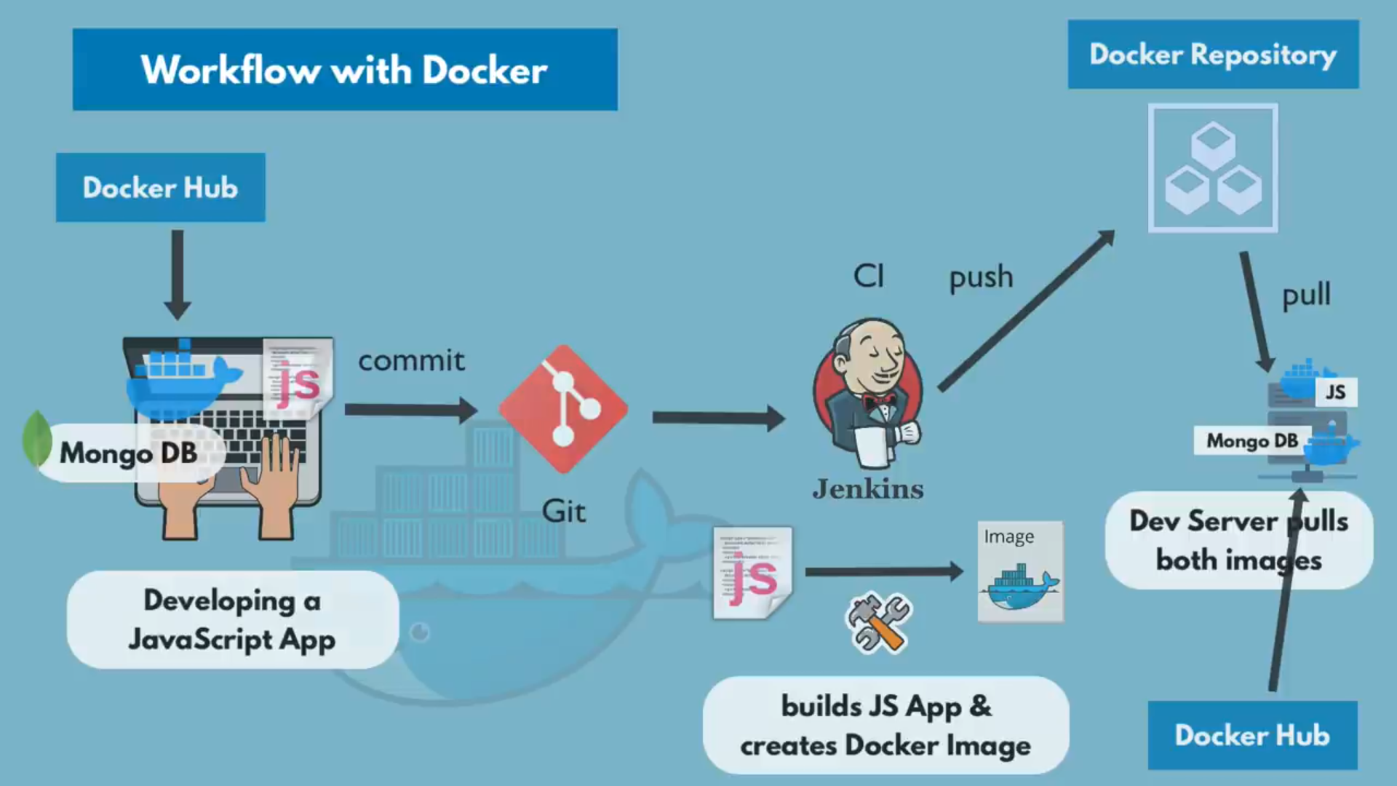

Slide 5
What is Docker?
Docker is a containerization tools which can create this VM docker engine
Container doesn't have any operating system
Docker is a velaxy container
Docker is a lightweight operating system
all types of requirements will pick from Docker Hub an run in container.
container is a type of virtual machine
Advantages of Docker?
No Pre-allocation of RAM
CI efficiency docker enables you build a container image and use that same image across every step of the deplanement process
Less cost
It is light weight(It will use less resource)
It can run in physical HW/ virtual HW or on cloud
You can re use the image
It took very less time to create container

Slide 6
Disadvantages of Docker?
Docker is not a good solution for application that required rich GUI
Difficult to manage large amount of containers
Docker does not provide cross platform compatibility means if an application is designed to run in a docker container on windows then it can't run on Linux
Docker is suitable when the development OS and testing OS are same
if the OS is different, we should use VM
How can you create container:
running state of image
When you run an image it wil become container, container will stop we call as image.
Image can transfer
Why do we need docker?
Capability dependency
long setup time
different dev/test/production environment

Slide 7
What container do?
containerization applications
Run each services with its own dependencies in separate containers
Docker Architecture?
A developer can write a docker file as per the requirement(dependencies)
run docker file in Docker Engine it will create an image, image to it will create a container
upload the images in Docker Hub(Registry) it can be useful for all the users
pull the image from Docker Hub and create a container.
container is a layered file system.
Ways to create am images:
1. Take image from docker Hub
2. Create image from docker file
3. Create image from existing docker containers
Docker Container:
Container hold the entire packages that is needed to run the application
container is like a virtual machine
Images becomes container when they run on docker engine

Slide 8
What is Docker?
Docker is a container, container is a docker.
Building containerization image
Running instance is of docker images is called as docker container.
Docker it build ship and run containerization app in your environment.
Docker Swarm:
Docker Swarm is a containerization catheterization engine produce from image.
What is Virtualization?
Multiple operating systems can run on the same machine
Maintenance and Recovery were easy in case of failure conditions
Total cost of ownership was also less due to the reduced need for infrastructure

Slide 9
Docker Ecosystem: Set of sw or pkgs
Docker client
Docker users interact with docker through a client
docker client users' commands rest API to communicate with the docker daemon commands to the docker daemon
when a client runs server commands on the docker client terminal, the client terminal send these docker
It is possible for docker client to communicate with more than one doeman
Docker Daemon/server/engine
Docker daemon runs the Host OS
It is responsible for running containers to manages docker services
Docker Hub(Registry)
Docker registry is a storage place and manages the docker images
there are two types of registries in the docker
a. Public Registry:
b. Private Registry:

Slide 10
Docker images (template)
Docker images are the read only binary templates used to create docker containers
single file with all dependencies and configuration required to run a program
Docker compose
Docker Host
Docker is used to provide an environment to execute and run applications it contains the docker doemon, images containers networks and storages

Slide 11
Basic Commands in Docker Sell all images present in your local machine: docker images Find out images in docker hub: docker search Jenkins/ubuntu/etc Download images from docker hub to local machine: docker pull Jenkins/ubuntu/etc TO give name to container: docker run -it --name Raham ubuntu /bin/bash To check service is start to not: service docker status TO start container: docker start Raham To go inside container: docker attach Raham To see all container: docker ps -a TO see only running container: docker ps => process status To stop container: docker stop Raham To delete container: docker rm Raham -i => interactive mode -t => terminal rum=>create and run ps => Process status(running container); -a=all(stop/running)

Slide 12
What is docker:
docker is an open-source container platform
designed to create deploy and run application
docker written in "go" language
docker is a tool that performs OS level virtualization also known as containerization
docker uses on the host os to run application it allows applications to use the same linux kernel as a system on the host computer
Advantages of Docker
No pre allocation of RAM
Docker enables you to build a container images and use that same images across every step of the deployment process
less cost
it's light weight
It can run on physical hardware / virtual hardware or on could
you can re-use the images
It took very less time to create container

Slide 13
Docker file, Docker Image And Docker Container:
Docker Image can be compared to a template which is used to create Docker Containers.
Docker Containers are the ready applications created from Docker Images.
1. A Docker Image is created by the sequence of commands written in a file called as Dockerfile.
2. When this Dockerfile is executed using a docker command it results into a Docker Image with a name.
3. When this Image is executed by “docker run” command it will by itself start whatever application or service it must start on its execution.
Docker Architecture:
It consists of a Docker Engine which is a client-server application with three major components:
Server: It is the docker daemon called dockerd. It can create and manage docker images. Containers, networks, etc.
Rest API: It is used to instruct docker daemon what to do.
Command Line Interface (CLI): It is a client which is used to enter docker commands.

Slide 14
Disadvantages(limitations) of Docker Docker is not a good solution for application that requires rich GUI Difficult to manage large amount of container Docker doesn't provide cross platform compatibility means if an application is designed to run in a docker container on windows, then its container in Linux or vice versa Docker is suitable when the development OS and testing OS are same, if the OS is different, we should use VM No solution for data recovery and backup Docker Architecture Developer can create the Dockerfile, once we run the Dockerfile it will create image. Image is called as Docker Engine or Docker Daemon. If run image it become container, if stop container it become image, so image is called as container, container called as image After creating image, it will store in Docker Hub or Docker Repository from here we will pull the images container call as layered file system.

Slide 15
Docker (Components)Ecosystem: Docker ecosystem contain set of software or packages Docker client docker user can interact with docker daemon through a client(CLI) docker client uses commands and rest API to community with the docker daemon when a client runs any server commands on the docker client terminal the client terminal sends the docker commands to the docker daemon it is possible for docker client to community with the more than one daemon Docker Daemon / Server docker daemon round on the Host OS It is responsible for running containers to manage docker services docker daemon can community with other daemons Docker Hub docker registry manage and store the docker images there are two types of registry in docker Public registry: it is called as docker hub private registry: it is used to store images within the enterprise Docker images docker images are the read only binary templates used to create docker containers single file with all dependencies and configuration required to run a program

Slide 16
Go to AWS Console => Go to AWS services => Select EC2 => click on running instances => Launch Instance => Select free EC2 instance(Amazon Linux2 AMI machine) => Select region => select t2 micro free tier => next => no of instances 1 next => storage by default next => Tag Name Docker next => SG My_SG SSH/HTTP TCP/TCP/ 22/80 Anywhere/Anywhere Review and Launch => Key pain Docker_key lunch, view instances

Slide 17
Most used docker commands
docker --version
docker –help
service docker status
docker info
Service docker start
service docker status
docker info
docker images
docker ps
docker ps –a
docker run –it ubuntu /bin/bash
docker pull
docker search ubuntu
docker run –it Raham ubuntu /bin/bash
docker ps -a
docker start Raham
docker stop Raham
docker attach Raham
docker rm Raham
docker diff Raham
docker commit Raham updateimage
docker run –it –name Raham updating /bin/bash
docker build
docker login
docker push
docker kill
docker rmi
docker exec
docker import
docker export
docker container
docker compose
docker swarm
docker service

Slide 18
Management Commands:
app* Docker App (Docker Inc., v0.9.1-beta3)
builder Manage builds
buildx* Build with BuildKit (Docker Inc., v0.6.3-docker)
config Manage Docker configs
container Manage containers
context Manage contexts
image Manage images
manifest Manage Docker image manifests and manifest lists
network Manage networks
node Manage Swarm nodes
plugin Manage plugins
scan* Docker Scan (Docker Inc., v0.8.0)
secret Manage Docker secrets
service Manage services
stack Manage Docker stacks
swarm Manage Swarm
system Manage Docker
trust Manage trust on Docker images
volume Manage volumes

Slide 19
Commands:
attach Attach local standard input, output, and error streams to a running container
build Build an image from a Dockerfile
commit Create a new image from a container's changes
cp Copy files/folders between a container and the local filesystem
create Create a new container
diff Inspect changes to files or directories on a container's filesystem
events Get real time events from the server
exec Run a command in a running container
export Export a container's filesystem as a tar archive
history Show the history of an image
images List images
import Import the contents from a tarball to create a filesystem image
info Display system-wide information
inspect Return low-level information on Docker objects
kill Kill one or more running containers
load Load an image from a tar archive or STDIN
login Log in to a Docker registry
logout Log out from a Docker registry

Slide 20
logs Fetch the logs of a container
pause Pause all processes within one or more containers
port List port mappings or a specific mapping for the container
ps List containers
pull Pull an image or a repository from a registry
push Push an image or a repository to a registry
rename Rename a container
restart Restart one or more containers
rm Remove one or more containers
rmi Remove one or more images
run Run a command in a new container
save Save one or more images to a tar archive (streamed to STDOUT by default)
search Search the Docker Hub for images
start Start one or more stopped containers
stats Display a live stream of container(s) resource usage statistics
stop Stop one or more running containers
tag Create a tag TARGET_IMAGE that refers to SOURCE_IMAGE
top Display the running processes of a container
unpause Unpause all processes within one or more containers
update Update configuration of one or more containers
version Show the Docker version information
wait Block until one or more containers stop, then print their exit codes

Slide 21
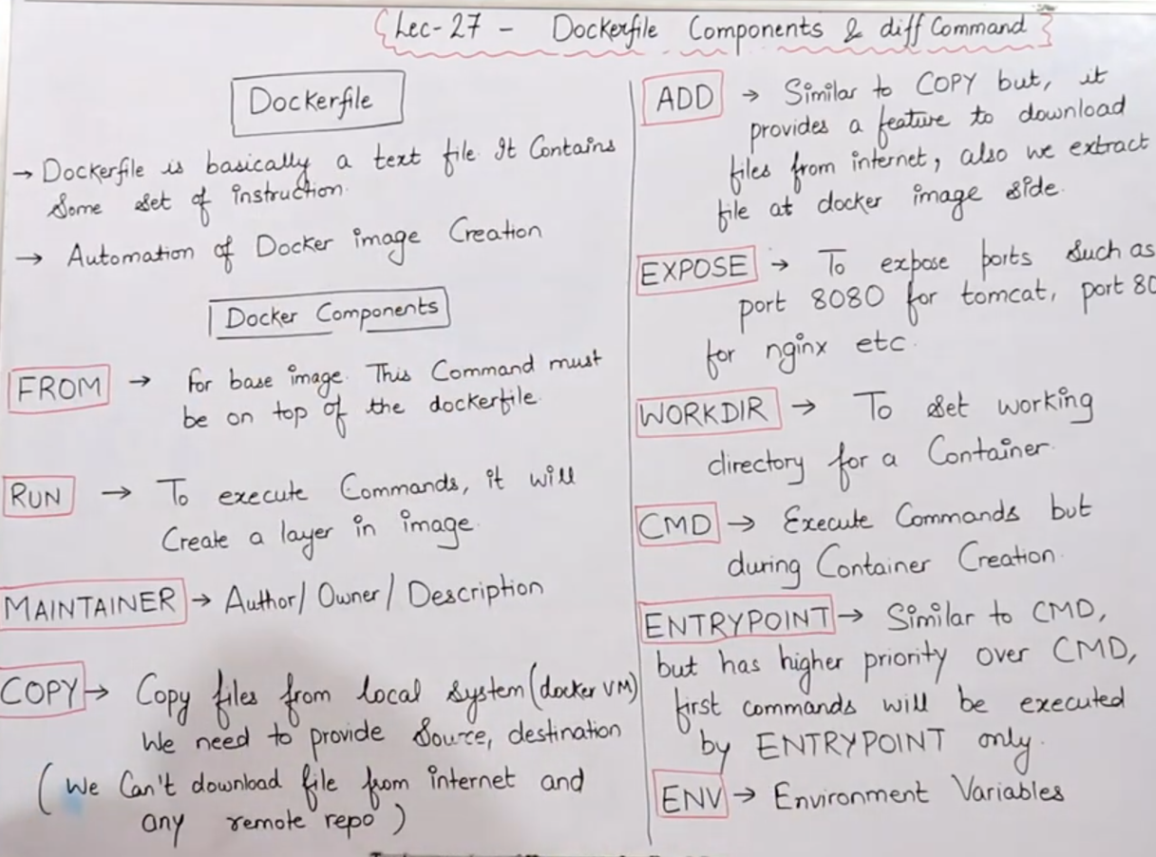

Slide 22
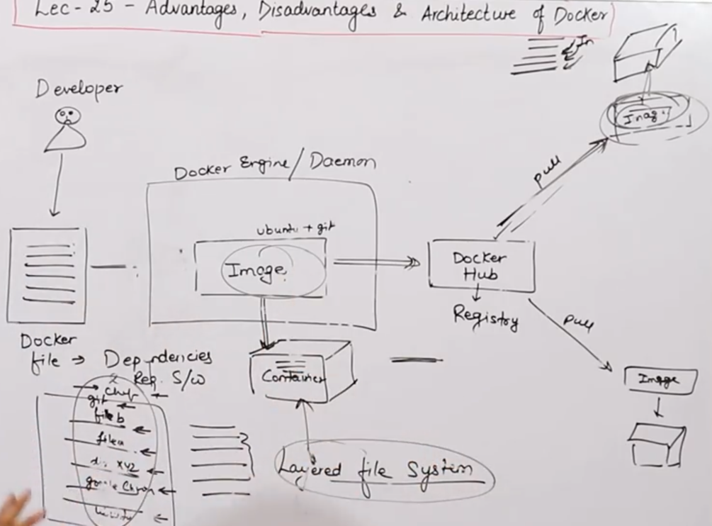

Slide 23
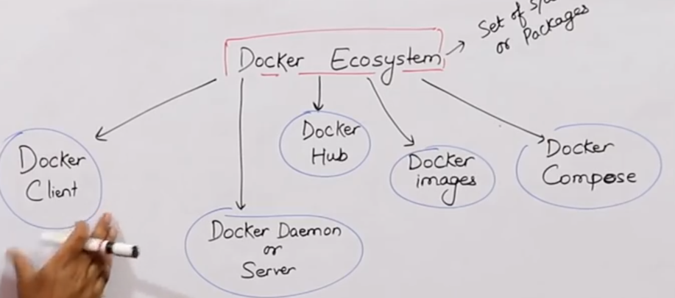

Slide 24
Go to AWS Console => Go to AWS services => Select EC2 => click on running instances => Launch Instance => Select free EC2 instance(Amazon Linux2 AMI machine) => Select region => select t2 micro free tier => next => no of instances 1 next => storage by default next => Tag Name Docker next => SG My_SG SSH/HTTP TCP/TCP/ 22/80 Anywhere/Anywhere Review and Launch => Key pain Docker_key lunch, view instances
Create Dockerfile
$ vi Dockerfile
FROM ubuntu
RUN echo "Subscribe technical guftgu" > /tmp/testfile.txt
Create test image using above Docker file
$ docker build -t test .
Create test container container using image
$ docker run -it --name testcontainer test /bin/bash

Slide 25
$ vi Dockerfile
FROM ubuntu
WROKDIR /tmp
RUN echo "Like my chanal" > /tmp/testfile
ENV myname Rahamthulla
COPY testfile1 /tmp
ADD test.tar.gz /tmp
$ touch testfile1 test => $tar -cvf test.tar test => $ ls
gzip test.tar
$ rm -rf test
$ docker build -t newimage .
$ docker images
$ docker run -it --name newcontainer newimage /bin/bash
$ ls

Slide 26
$ vi Dockerfile
FROM ubuntu
VOLUME ["/myvolume"]
docker build -t myimage .
docker images
docker run -it --name container myimage /bin/bash
$ docker run -it --name container2 --privileged=true --volumes-from container1 ubuntu /bin/bash
$ docker start container1
$ docker attach container1
Docker Volume & How to share it
Now try to create volume by using command
docker run -it --name container3 -v /volume2 ubuntu /bin/bash
Do $ ls -> $ cd volume2 => $ touch vol1 vol2 vol3 => exit
Now create one more container and share volume2
Container contain only software
$ docker run -it --name container4 --privileged=true --volumes-from container3 ubuntu /bin/bash
$ ls

Slide 27
Now you are inside container do ls you can see volume2
Now create one file inside this volume and then check in container3, you can see that file
$ cd volume2 => $ touch raham sufyan suhana => $ ls => exit
$ docker start container3
$ docker attach container3
$ cd volume2 => ls
Volumes(Host - Container)
verify files in /home/ec2-user
$ docker run -it --name hostcost -v /home/ec2-user:/Raham --privileged=true ubuntu /bin/bash
$ cd /Raham => ls
$ docker start hostcont
$ docker attach hostcont
$ cd Raham => toucj xyz pqr => exit => ls
$ docker volume ls
$ docker volume create <volumename>
$ docker volume rm <volumename> => used volume can delete
$ docker volume prune <volumename> => remove all unused docker volume
$ docker volume inspect <volumename>
$ docker container inspect <volumename>

Slide 28
Docker Port Expose
service docker start
docker -td --name teshserver -p 80:80 ubuntu
=> -d = daemon
=> -p = port/publish
doccker ps
docker port techserver
o/p 80/tcp -> 0.0.0.0/80
docker exec -it techserver /bin/bash
apt-get update
apt-get install apache2 -y
cd /var/www/html
echo "Hi Rahamthulla." > index.html
service apache2 start
Check in browser using IPAddress
docker run -td --name myjenkins -p 8080:8080 jenkins
Go to EC2 instance select security => Inbound rules => inbound edit
Add rule => custome TCP 8080 => custom => 0.0.0.0 => save
Difference between docker attach and docker exec
Docker exec: create a new process in the container's environment while docker attach just connect the standard input/output of the main process inside the container to corresponding standard input/output error of current terminal
Docker exec: is specifically for running new things in a alread started container be it a shell or some of the process

Slide 29
What is the difference between expose and publish a docker?
Basically, you have three options:
1. Neither specify expose nor -p
2. Only specify exepose
3. specify expose and -p
If you specify neither expose nor -p the service in the container will only be accessible from inside the container itself
if you expose a port the service in the container is not accessible from outside docker but from inside other docker containers so this is good from containers communication
How to push docker image in docker hub
Go to AWS account -> select Amazon Linux now go to putty login as ec2-user
sudo su
yum update -y
service docker start
docker run -it ubuntu /bin/bash
touch file1 file2 file3
cd tmp && touch file4 file5 and exit => now you in host machine
docker images
docker ps -a
docker commit yourcontainername image1

Slide 30
now create some files inside container, create image of this container
docker commit container1 image1
docker images
now create account in hub.docker.com
docker login
enter your username and password, Now give tag to your image
docker tag image1 raham/project1
docker push raham/project1 <= image1 is pushed with the help of raham/project1 name
can see this image in docker hub account, now create one instance in Tokyo region and pull image from hub.
sudo su && apt-get update
apt-get install docker && service docker start && docker images
docker pull raham/project1 && docker images <= bring the images from docker hub
docker run -it --name mycontainer raham/project1 /bin/bash <= create container from images
ls <= check files which has created.
How to set the permissions to dockerhub:
click on you image => click on setting => click on private write private.
docker pull raham/project1 <= get error

Slide 31
LAB
sudo apt-get update
sudo apt-get install docker
docker -v / docker --version =>docker 19.0
service docker status / docker info
service docker stop
service docker start
sudo docker images => display docker images
sudo docker ps => process status(running containers)
sudo docker ps -a => process status(both(running/stoped) containers)
https://hub.docker.com/
sudo docker run -it ubuntu /bin/bash => Create and switch in to docker container
sudo docker images
sudo docker ps -a
sudo docker run -it ubuntu /bin/bash => If you run the same commandi it will create new container
sudo docker ps -a
sudo docker run -it centos /bin/bash
sudo docker images
sudo docker run -i -t centos /bin/bash
sudo docker images

Slide 32
sudo docker search Jenkins => Search all Jenkins images from docker hub
sudo docker pull Jenkins => pull the Jenkins image from docker hub to local
sudo docker images
$ sudo docker run -it --name rahamthulla ubuntu /bin/bash
=> run ubuntu container with the your name
sudo docker start rahamthulla => Start container
sudo docker attach rahamthulla => Enter inside the container
Start/Stop containers
exit from contain it will stopo else
sudo docker stop rahamthulla
Delete container
if contain is running stop and delete
sudo docker stop rahamthulla
sudo docker rm Rahamthulla
start & switch into container, do some operations and check diff
raham@ubuntu:~$ sudo docker start rahamthulla
raham@ubuntu:~$ sudo docker attach rahamthulla
root@903334b0849c:~# mkdir tmp && cd tmp/
root@903334b0849c:~/tmp# touch sample1 sample2 sample3 && root@903334b0849c:~/tmp# exit

Slide 33
raham@ubuntu:~$ sudo docker diff rahamthulla
C /root C => Change A=> Add M => Modify
A /root/tmp
A /root/tmp/sample1
A /root/tmp/sample2
A /root/tmp/sample3
A /root/.bash_history
raham@ubuntu:~$ sudo docker commit rahamthulla updateimage
sha256:2b15d50bf067ee07e8802145d23bcd2bbd2ee695bb201b053f403092135fdc83
raham@ubuntu:~$ sudo docker images
REPOSITORY TAG IMAGE ID CREATED SIZE
updateimage latest 2b15d50bf067 36 seconds ago 72.8MB
ubuntu latest 2b4cba85892a 2 days ago 72.8MB
jenkins/jenkins latest 8abb1f037d12 5 days ago 463MB
centos latest 5d0da3dc9764 5 months ago 231MB
Suhana container will create from rahamthulla container
raham@ubuntu:~$ sudo docker run -it --name suhana updateimage /bin/bash
check => cd tmp && ls
Dockerfile creation => In Dockerfile D is capital there is no other file names except Dockerfile

Slide 34
$ vi Dockerfile
FROM: ubuntu
RUN echo "Bismilla Plzstart........" > /tmp/test.txt
$ sudo docker build -t test .
Sending build context to Docker daemon 2.048kB
Step 1/2 : FROM ubuntu
---> 2b4cba85892a
Step 2/2 : RUN echo "Hello Raham" > /tmp/test.txt
---> Running in 3f133e0c0b76
Removing intermediate container 3f133e0c0b76
---> 12908d025035
Successfully built 12908d025035
Successfully tagged test:latest
$ sudo docker images
REPOSITORY TAG IMAGE ID CREATED SIZE
test latest 12908d025035 About a minute ago 72.8MB
$ sudo docker run -it --name raham test /bin/bash
root@aabc0ccfa7fd:/# cd tmp/
root@aabc0ccfa7fd:/tmp# ls
test.txt
root@aabc0ccfa7fd:/tmp# cat test.txt
Hello Raham

Slide 35
$ vi Dockerfile
FROM ubuntu
WORKDIR /tmp
RUN echo "Like my CHannel......" > /tmp/testfile
ENV myname rahamthulla
COPY testfile1 /tmp
ADD test.tar.gz /tmp
Local/EC2 PC changes
$ touch testfile1 test
$ ls
Dockerfile test testfile1
$ tar -cvf test.tar test
test
$ ls
Dockerfile test testfile1 test.tar
$ gzip test.tar
$ rm test
$ ls
Dockerfile test testfile1 test.tar.gz
$ ls
Dockerfile testfile1 test.tar.gz

Slide 36
$ sudo docker build -t newimage .
Sending build context to Docker daemon 3.584kB
Step 1/6 : FROM ubuntu
---> 2b4cba85892a
Step 2/6 : WORKDIR /tmp
---> Running in 2be4319ca219
Removing intermediate container 2be4319ca219
---> 97822414c009
Step 3/6 : RUN echo "Like my CHannel......" > /tmp/testfile
---> Running in 5432629a0f7d
Removing intermediate container 5432629a0f7d
---> d17b716cfceb
Step 4/6 : ENV myname rahamthulla
---> Running in 8d7c00350a29
Removing intermediate container 8d7c00350a29
---> eb52186007cb
Step 5/6 : COPY testfile1 /tmp
---> 8c9978370322
Step 6/6 : ADD test.tar.gz /tmp
---> 05338eec10ea
Successfully built 05338eec10ea
Successfully tagged newimage:latest

Slide 37
root@58475826ec62:/tmp# ls
test testfile testfile1
root@58475826ec62:/tmp# cat testfile
Like my CHannel......
root@58475826ec62:/tmp# echo $myname
rahamthulla
Docker Volume & How to share it
You can declare a directory as a volume only while creating container
touch file1 file2 && ls
$ service docker status
vi Dockerfile
FROM ubuntu
VOLUME ["/Myvolume"]
sudo docker build -t myimage .
sudo docker images
sudo docker run -it --name container1 myimage /bin/bash
# cd Myvolume/
root@5a201ae26aed:/Myvolume# ls && touch a1 a2 a3
exit

Slide 38
sudo docker run --it --name container2 --privileged=true --volumes-from container1 ubuntu /bin/bash
root@b3cceefe58ab:/Mvolume# ls
a1 a2 a3
sudo docker start container1
sudo docker attach container1
cd Myvolume => do as you like
sudo docker start container2
sudo docker attach container2
cd Myvolume => do as you like
same changes you can view/read/write from container1/2
sudo docker run -it --name container3 -v /volume2 ubuntu /bin/bash
root@b7bdb2df7787:/# cd volume2/
root@b7bdb2df7787:/volume2# touch vol1 vol2 vol3 vol4
root@b7bdb2df7787:/volume2# ls
vol1 vol2 vol3 vol4
sudo docker run -it --name container4 --privileged=true --volumes-from container3 ubuntu /bin/bash
root@5c596d5d880c:/# cd volume2/
root@5c596d5d880c:/volume2# ls
vol1 vol2 vol3 vol4

Slide 39
Volumes(Host - COntainer)
sudo docker run -it --name hostcontainer -v /home/raham/dockerarea:/raham --privileged=true ubuntu /bin/bash
root@ea00d454e543:/raham# ls
Dockerfile file1 file2 test.tar.gz testfile1
exit
raham@ubuntu:~/dockerarea$ ls
Dockerfile file1 file2 test.tar.gz testfile1
raham@ubuntu:~/dockerarea$ touch text.txt
raham@ubuntu:~/dockerarea$ ls
Dockerfile file1 file2 testfile1 test.tar.gz text.txt
aham@ubuntu:~/dockerarea$ sudo docker start hostcontainer
hostcontainer
raham@ubuntu:~/dockerarea$ sudo docker attach hostcontainer
root@ea00d454e543:/# cd raham/
root@ea00d454e543:/raham# ls
Dockerfile file1 file2 test.tar.gz testfile1 text.txt
oot@ea00d454e543:/raham# rm text.txt
root@ea00d454e543:/raham# exit
exit
raham@ubuntu:~/dockerarea$ ls
Dockerfile file1 file2 testfile1 test.tar.gz

Slide 41
THE END

